Slide 1


CMPE 135: Object-Oriented Analysis and Design November 9 Class Meeting
Department of Computer Engineering San Jose State University Fall 2017 Instructor: Ron Mak
www.cs.sjsu.edu/~mak

Slide 2
Design Patterns
Strategy
Observer
Decorator
Factory Method
Abstract Factory
Singleton
Adapter

Slide 3
The Facade Pattern
The Adapter Pattern converts the interface of a class to one that the client expects.
Wrap the object that has the incompatible interface with an object that implements the correct interface.
The Facade Pattern alters an interface in order to simplify the interface.
Hide the complexity of one or more classes behind a clean, well-designed facade.
These examples and their images are from
Head First Design Patterns
by Eric & Elizabeth Freeman
O’Reilly, 2004

Slide 4
Example: Home Theater

Slide 5
Watch a Movie the Hard Way
Turn on the popcorn popper
Start the popper popping
Dim the lights
Put the screen down
Turn the projector on
Set the projector input to DVD
Put the projector on wide-screen mode
Turn the sound amplifier on
Set the amplifier to DVD input
Set the amplifier to surround sound
Set the amplifier volume to medium (5)
Turn the DVD player on
Start the DVD player playing

Slide 6
Watch a Movie the Hard Way, cont’d

Slide 7
More Complexities
When the movie is over, how do you turn everything off?
Wouldn’t you have to do all of this over again, in reverse?
Wouldn’t it be as complex to listen to a CD or the radio?
If you decide to upgrade your system, you’re probably going to have to learn a slightly different procedure.

Slide 8
Simplify with the Facade Pattern
Simplify a complex system by implementing a Facade class that provides a more reasonable interface.
If necessary, you can still go behind the facade to access the underlying complex system.

Slide 9
Simplify with the Facade Pattern, cont’d

Slide 10
Adapter vs. Facade Patterns
They differ in intent.
The Adapter Pattern alters an interface to match one that the client expects.
The Facade Pattern provides a simplified interface to a complex subsystem.
The Facade Pattern decouples a client from a subsystem of components.

Slide 11
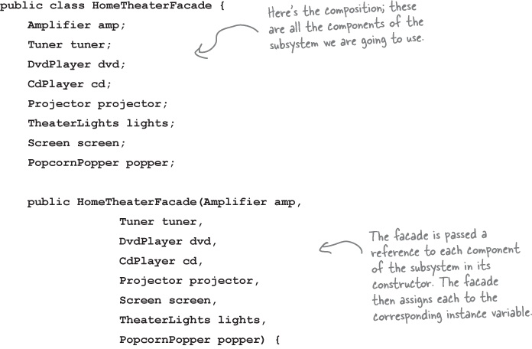
The Home Theater Facade

Slide 12
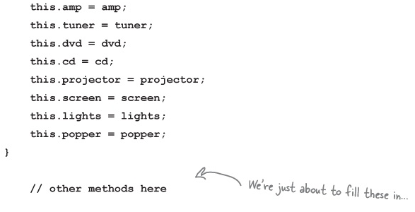
The Home Theater Facade, cont’d

Slide 13
Implementation

Slide 14
Watch a Movie the Easy Way

Slide 15
Watch a Movie the Easy Way, cont’d

Slide 16
Facade Design Pattern Defined
The Facade Design Pattern provides a unified interface to a set of interfaces in a subsystem.
Facade defines a higher-level interface that makes the subsystem easier to use.
It allows us to avoid tight coupling between clients and subsystems

Slide 17
Principle of Least Knowledge
AKA Law of Demeter.
From any member function of an object, you may only call functions that belong to:
The object itself
Objects passed in as a parameter to the function
Any object the function creates or instantiates
Any components of the object
The member function should not call a member function of an object returned from another call.

Slide 18
Principle of Least Knowledge, cont’d

Slide 19
Principle of Least Knowledge, cont’d

Slide 20
Principle of Least Knowledge, cont’d
The Facade Design Pattern
supports the Principle of
Least Knowledge.

Slide 21
The State Design Pattern
The State Pattern helps objects control their behavior by changing their internal state.
Example: Design code to monitor the state of gumball machines.

Slide 22
The State Design Pattern, cont’d

Slide 23
State Machine Code
Gather states

Slide 24
State Machine Code, cont’d
Hold the current state in an instance variable.
Define values for each of the states.

Slide 25
State Machine Code, cont’d
Gather all the actions that can happen in the system.

Slide 26
State Machine Code, cont’d
Create the state machine class.
For each action, create a function that uses conditional statements to determine what behavior is appropriate in each state.

Slide 27
State Machine Code, cont’d

Slide 28
State Machine Code, cont’d

Slide 30
Testing

Slide 31
A Change Request

Slide 32
Hard to Extend the Code

Slide 33
The New Design
Define a State interface that contains a function for every Gumball Machine action.
Implement a State class for every state of the machine.
These classes will be responsible for the behavior of the machine when it is in the corresponding state.
Get rid of all of our conditional code and instead delegate to the State class to do the work for us.

Slide 35
Implement the State Classes

Slide 36
Rework the Gumball Machine

Slide 39
The SoldState Class

Slide 40
Our Accomplishments
We now have a Gumball Machine implementation that is structurally quite different from the first version, and yet functionally it is exactly the same.

Slide 41
Our Accomplishments, cont’d
Localized the behavior of each state into its own class.
Removed all the troublesome if statements that would have been difficult to maintain.
Closed each state for modification, and yet left the Gumball Machine open to extension by adding new state classes.
Created a code base and class structure that maps much more closely to the Mighty Gumball diagram and is easier to read and understand.

Slide 42
Functional Aspects

Slide 44
State Design Pattern Defined
The State Design Pattern allows an object to alter its behavior when its internal state changes.
The object will appear to change its class.
If an object you’re using can completely change its behavior, then it appears that the object is actually instantiated from another class.
In reality, however, we are using composition to give the appearance of a class change by simply referencing different state objects.

Slide 45
State Pattern Class Diagram

Slide 46
Complete the Gumball 1 in 10 Game

Slide 47
Complete the Game, cont’d

Slide 49
Final Test Run

Slide 50
Final Test Run, cont’d

